Slide 1



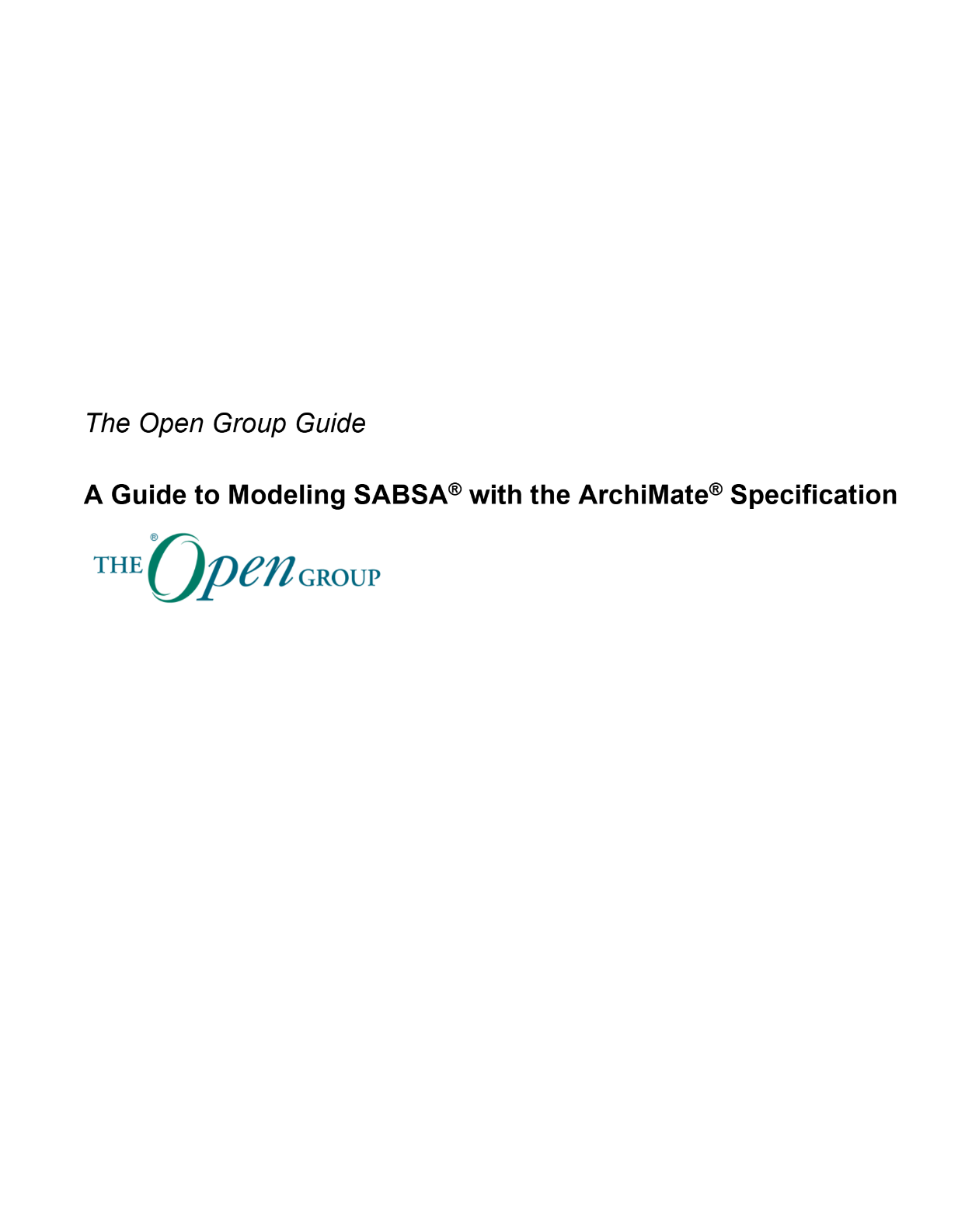
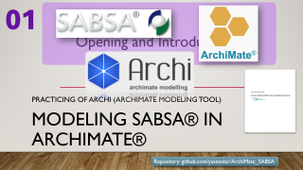
Modeling SABSA® in ArchiMate®
01
Opening and Introduction
Practicing of Archi (ArchiMate Modeling Tool)
Repository: github.com/yasenstar/ArchiMate_SABSA

Slide 2








About Me – An Enterprise Architecture Practitioner
Journey with The Open Group
TOGAF 9 Certified: 2013
ArchiMate 3 Practitioner: 2021
Professional Level 2 Architect: 2021
ArchiMate Essential 3.2: 2025
Other Architecture Learning
Certified Business Architect: 2021
Journey with ISACA
CobiT Certified: 2006
CISA – Info Sys Auditor: 2007
CISM – Info Sec Mgr: 2007
CGEIT GrandFather Certified: 2008
CRISC – Risk & InfoSys Control: 2017
CDPSE – Data Privacy Solution: 2020
Other Security and Service Mgmt
ITIL Manager Certified: 2002
PMP: 2003
CISSP: 2016
Security Journey – White/Yellow/Green Belt: 2024
Repository: github.com/yasenstar/ArchiMate_SABSA
Notes:
COBIT: Control Objectives for Information and Related Technology

Slide 3


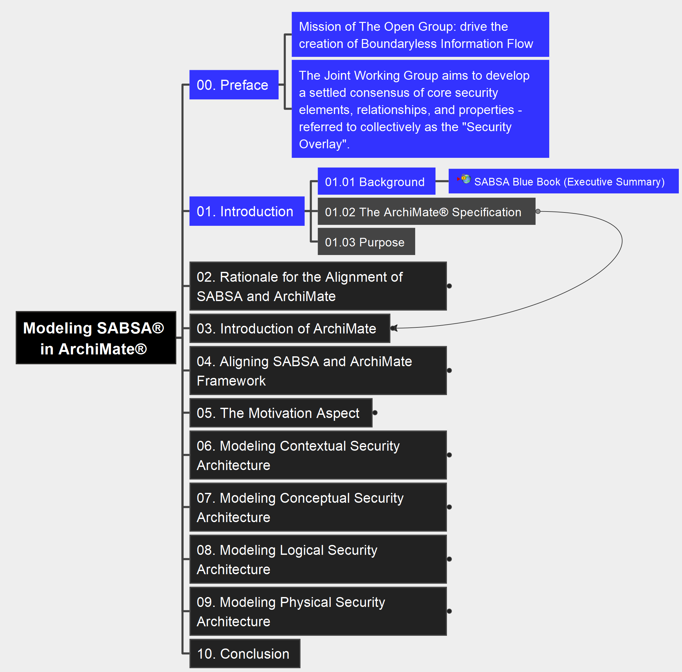
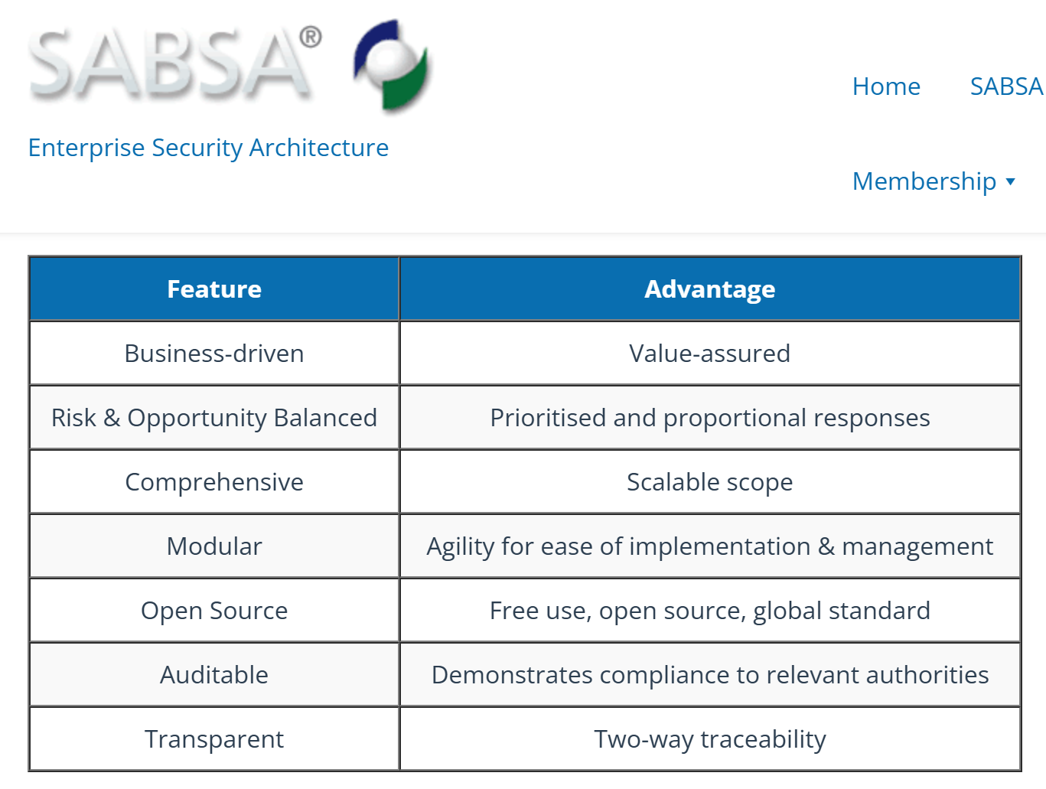
01 Introduction – Preface & Background
02
Modeling SABSA® in ArchiMate® Specification

Slide 4

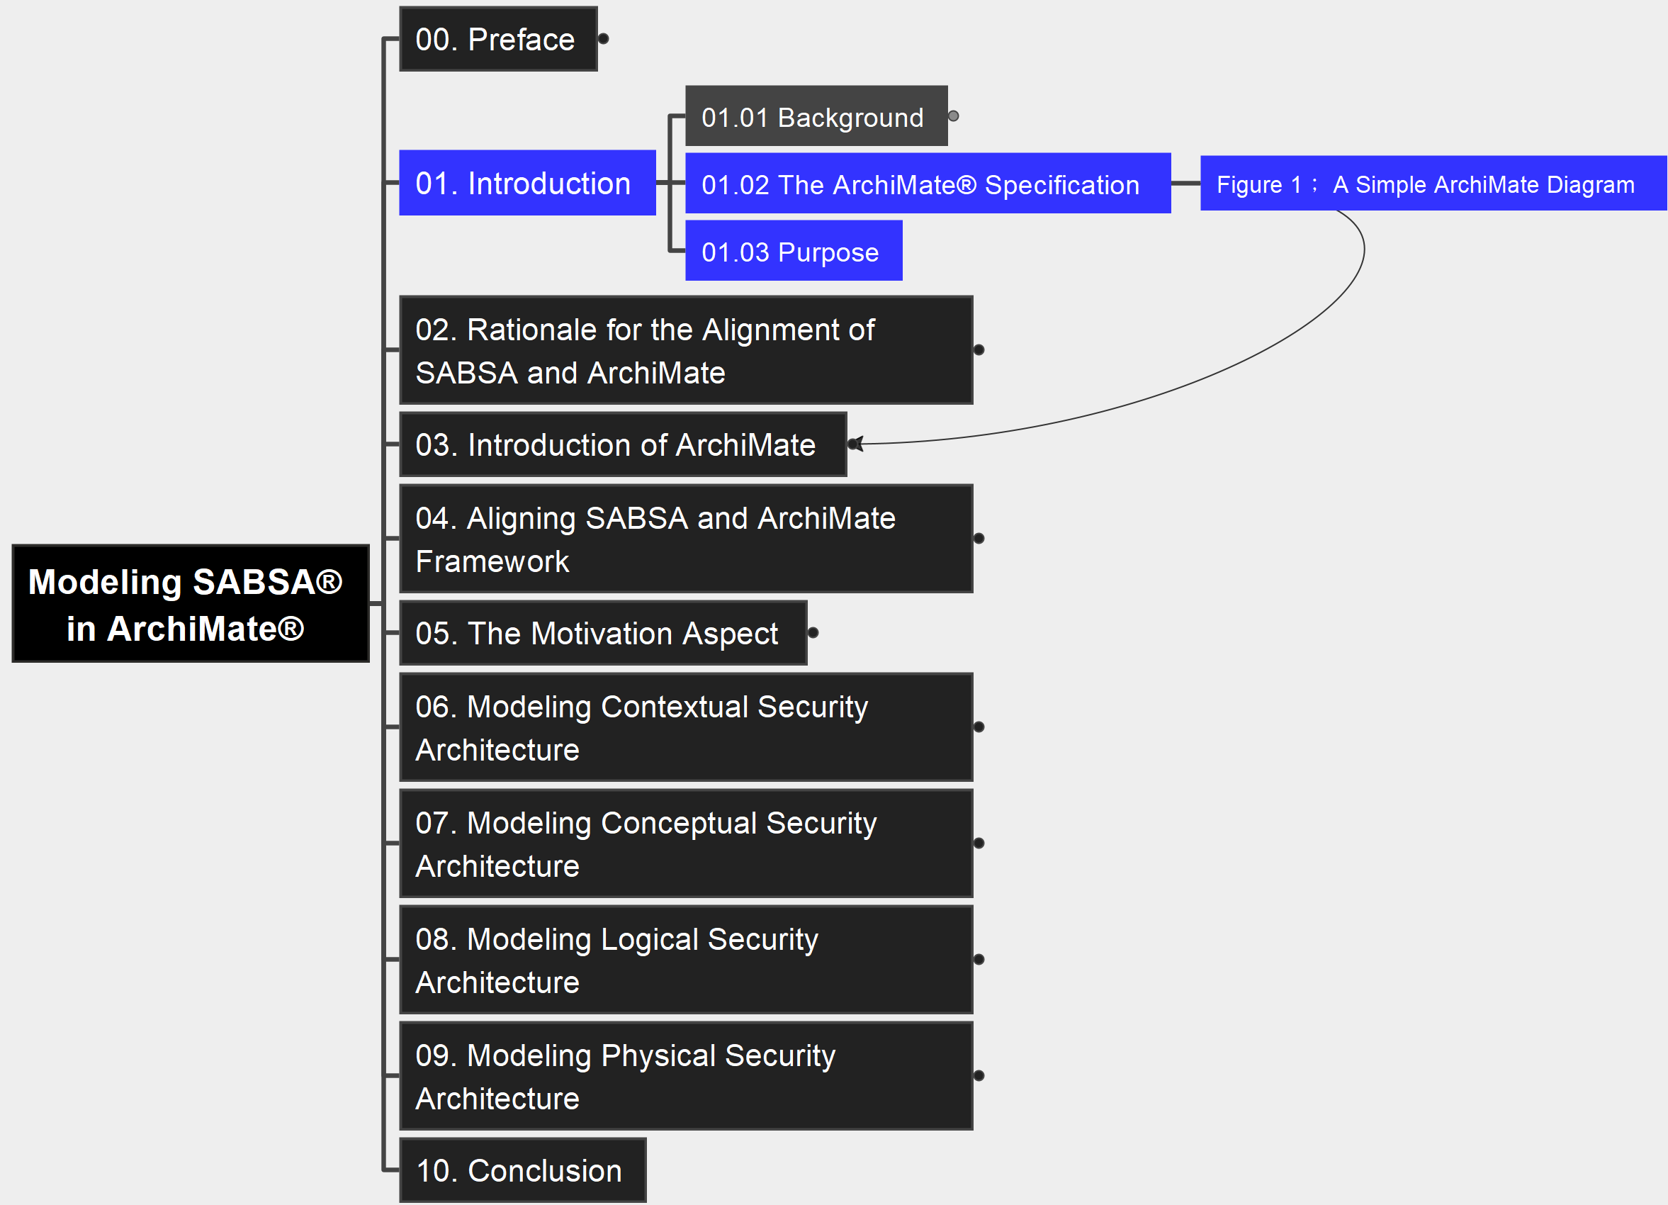
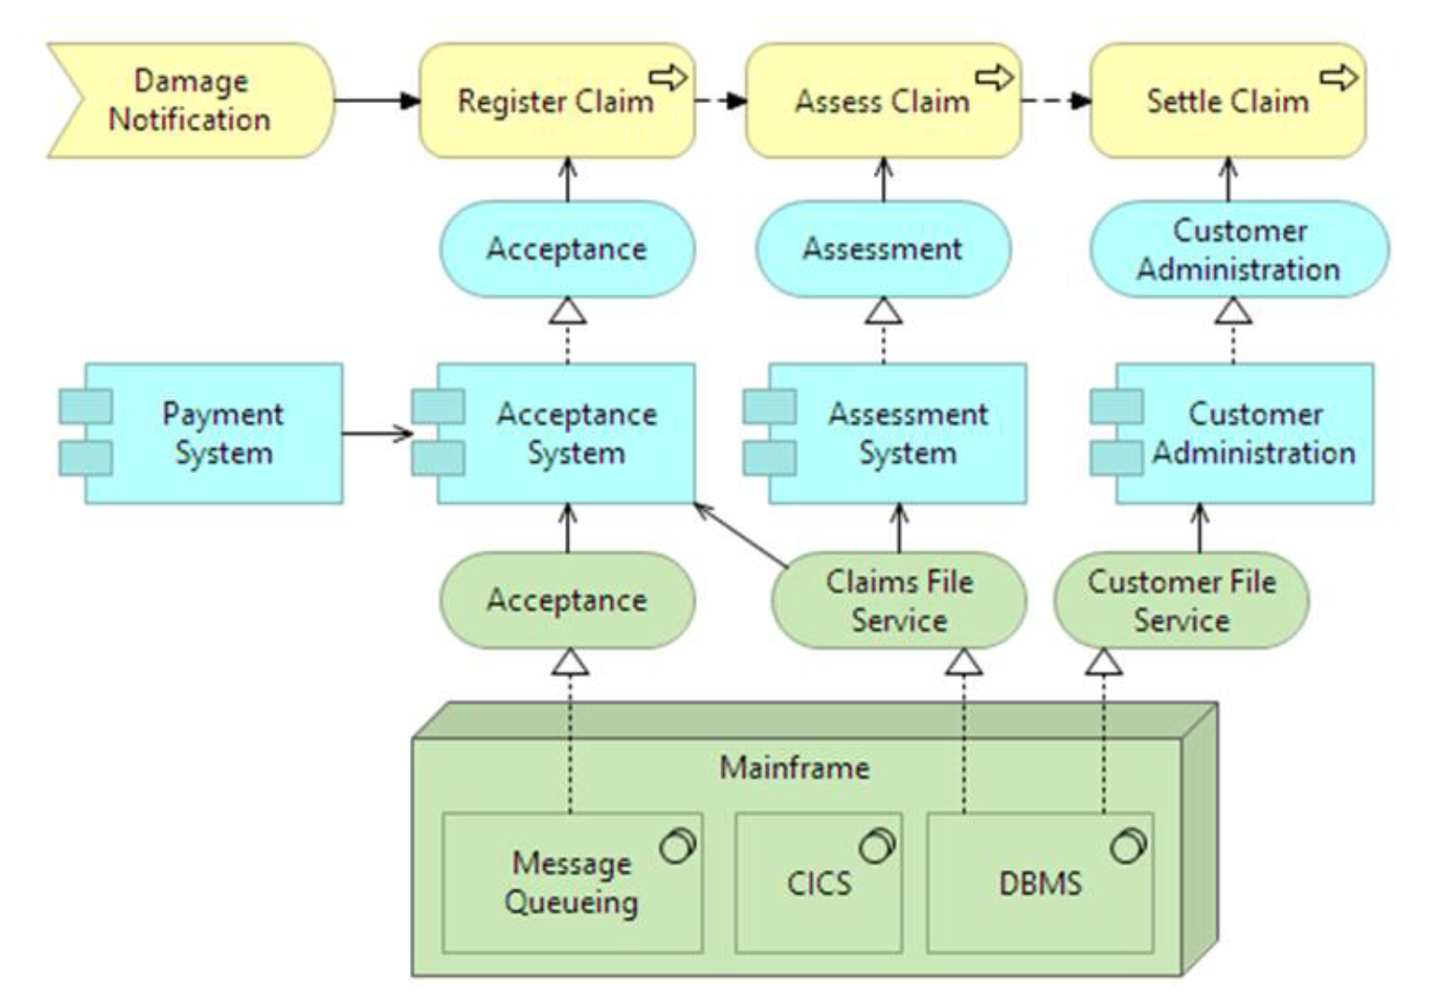
01 Introduction Figure 1: A Simple ArchiMate Diagram
03
Modeling SABSA® in ArchiMate® Specification

Slide 5
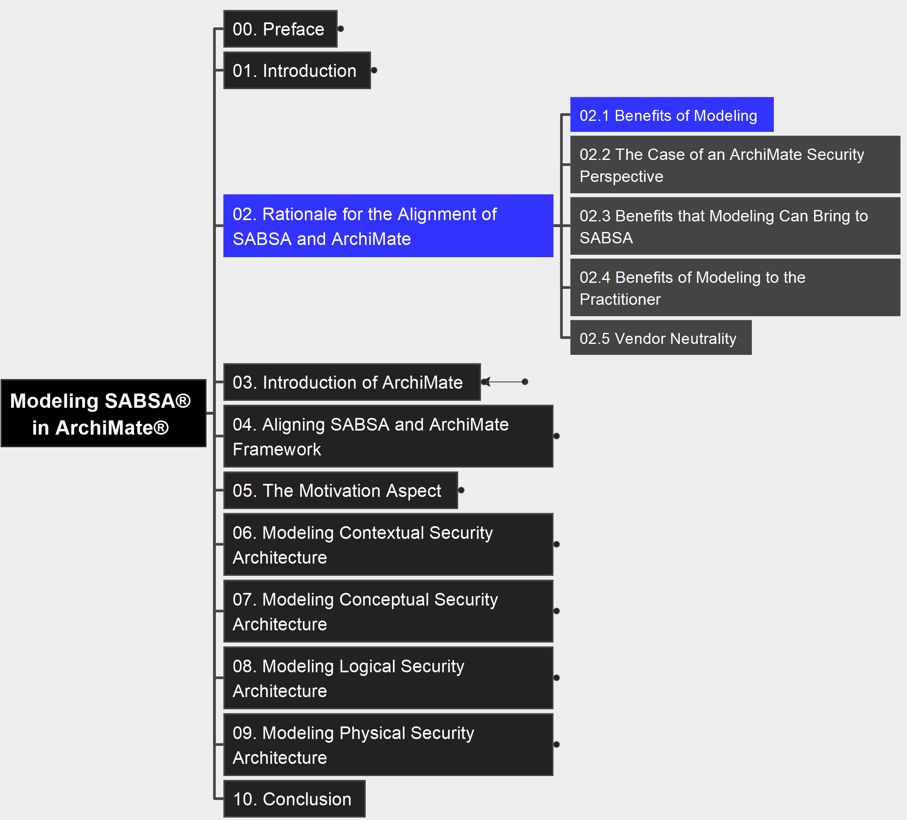
02 Rationale for the Alignment 2.1 Benefits of Modeling
04
Modeling SABSA® in ArchiMate® Specification
Modeling
Resolving Complexity
Quality of Documentation
Efficiency
Better Collaboration
Reuse
Stakeholder Buy-in
Standardization

Slide 6
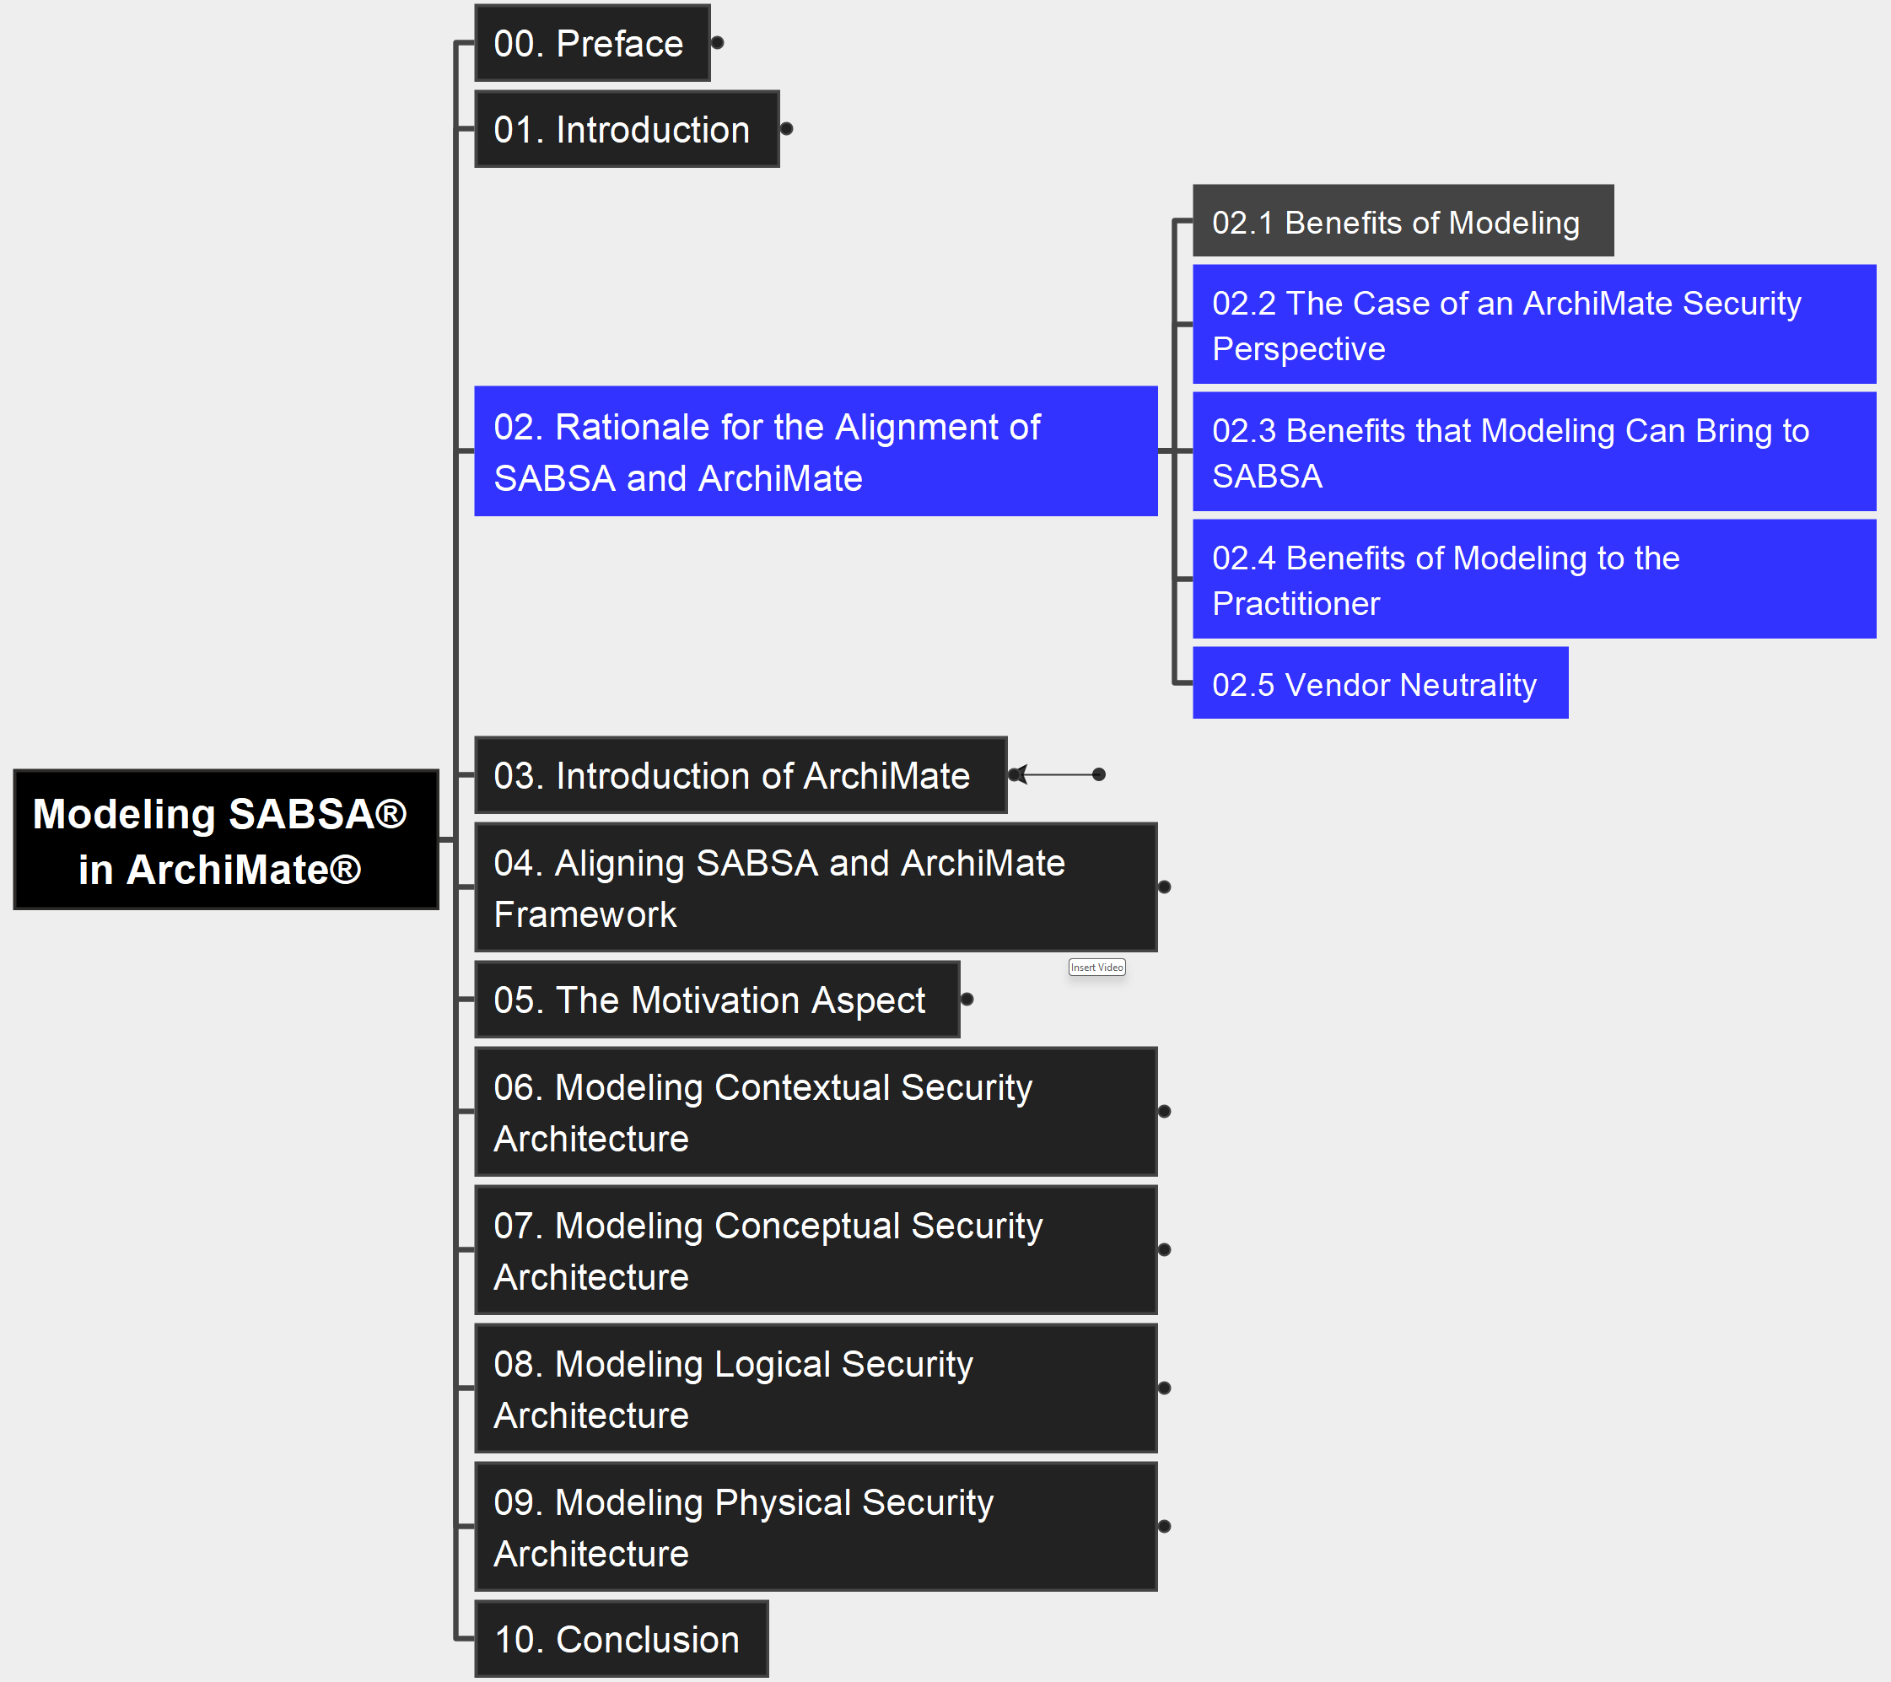
02 Rationale for the Alignment 2.2~2.5 Benefits to Variable Parties
05
Modeling SABSA® in ArchiMate® Specification
Security Overlay

Slide 7
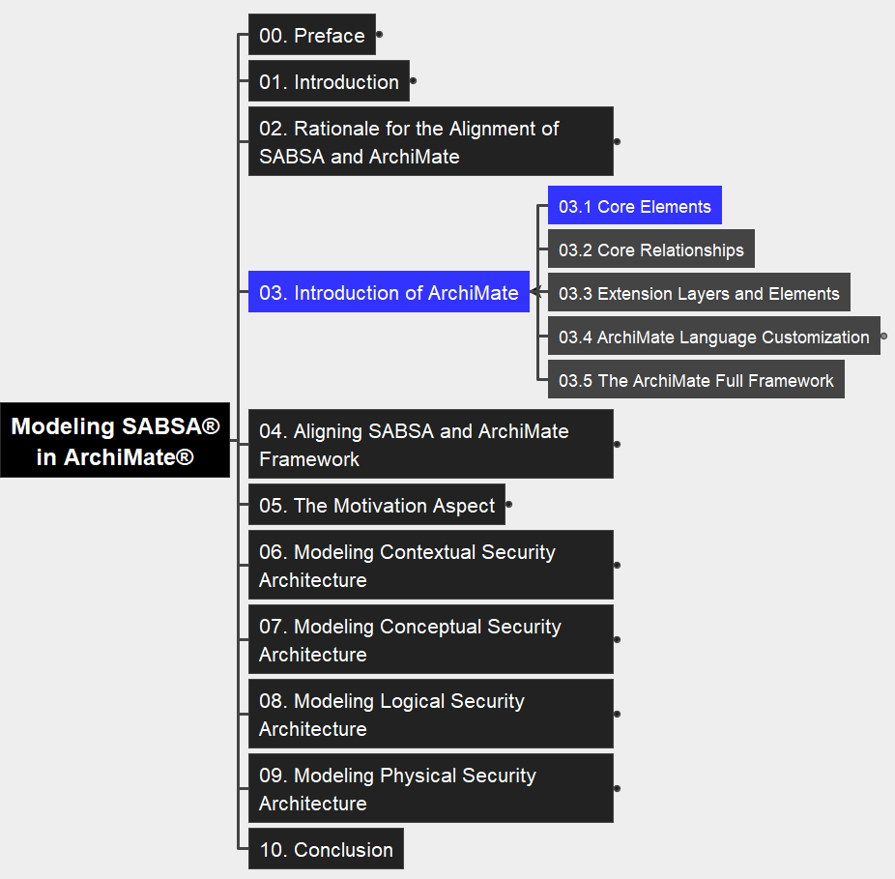
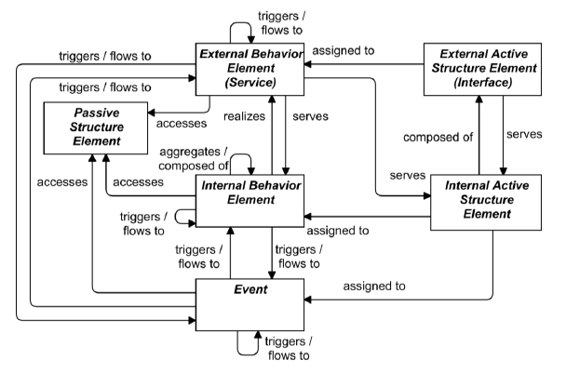
03 An Introduction to ArchiMate Language 3.1 Core Elements
06
Modeling SABSA® in ArchiMate® Specification

Slide 8
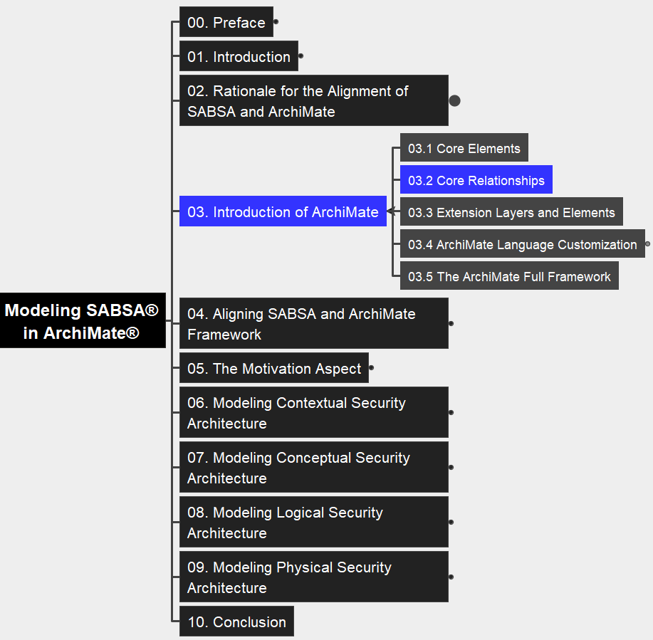
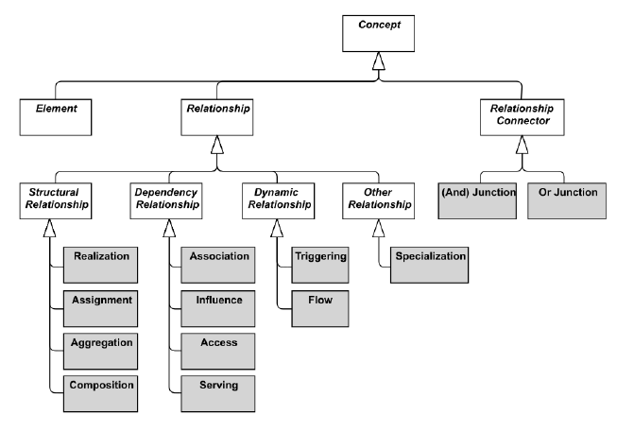
03 An Introduction to ArchiMate Language 3.2 Core Relationships
07
Modeling SABSA® in ArchiMate® Specification

Slide 9
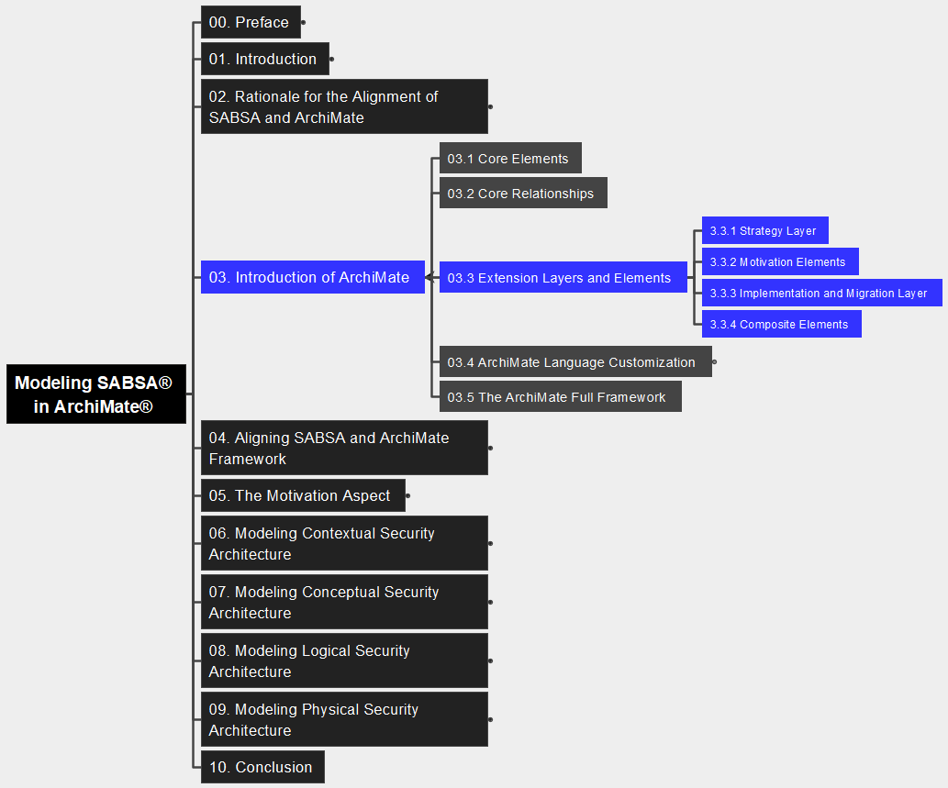
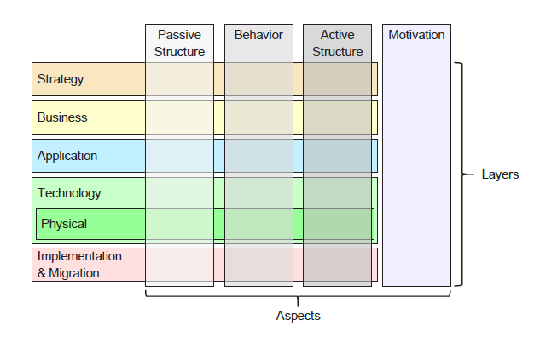
03 An Introduction to ArchiMate Language 3.3 Extension Layers and Elements
08
Modeling SABSA® in ArchiMate® Specification

Slide 10
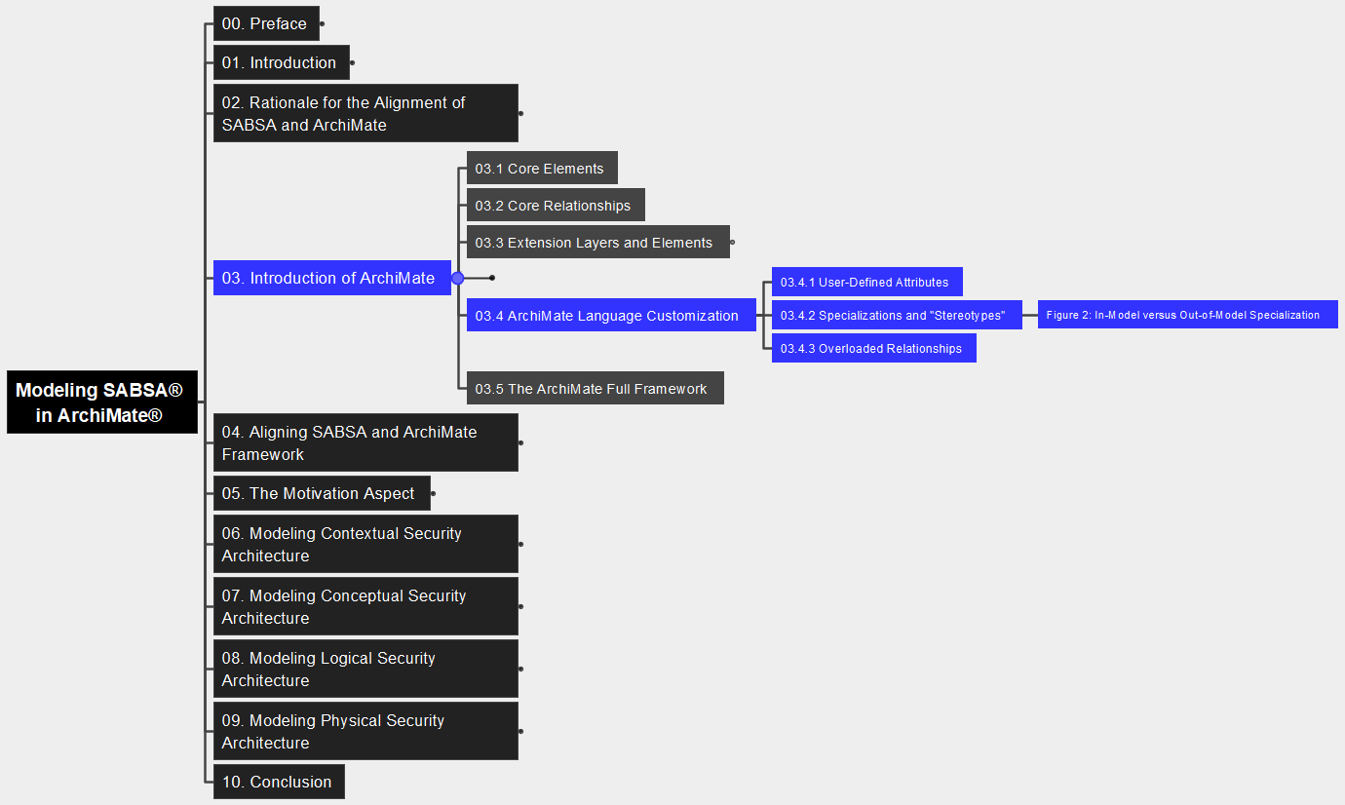
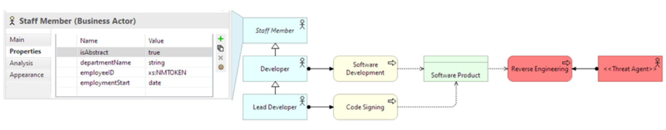
03 An Introduction to ArchiMate Language 3.4 ArchiMate Language Customization
09
Modeling SABSA® in ArchiMate® Specification

Slide 11
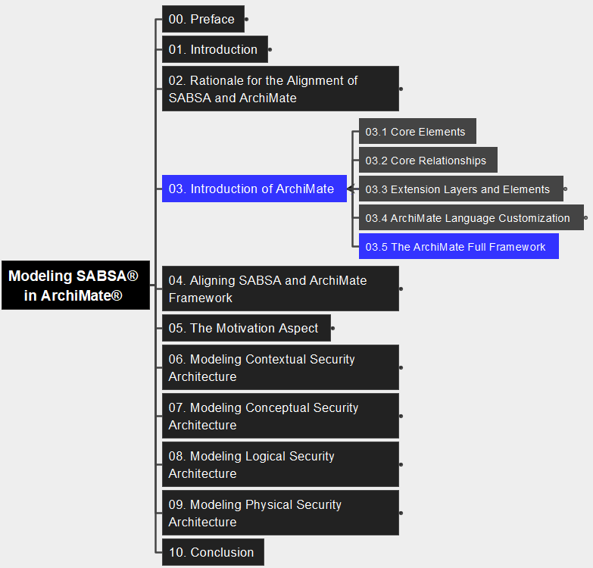
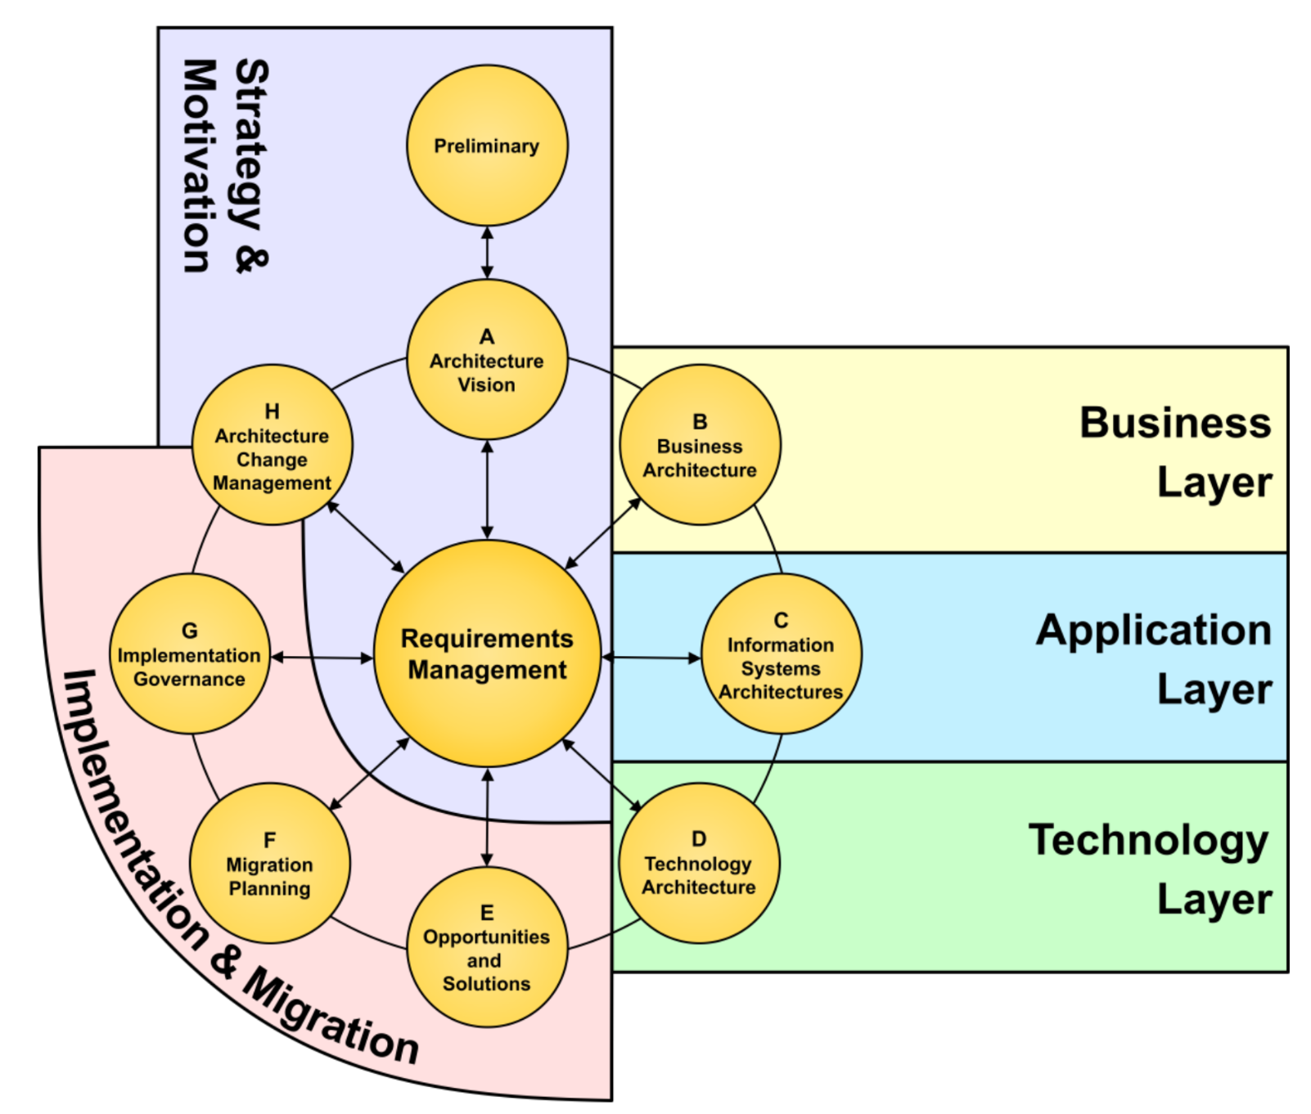
03 An Introduction to ArchiMate Language 3.5 The ArchiMate Full Framework
10
Modeling SABSA® in ArchiMate® Specification

Slide 12
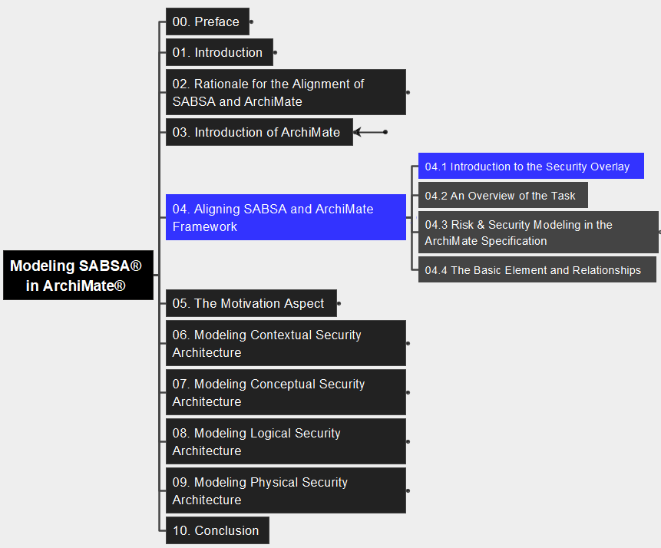
04 Aligning SABSA and ArchiMate 4.1 Intro to the Security Overlay
11
Modeling SABSA® in ArchiMate® Specification
A Security Overlay is a set of security profiles for existing ArchiMate elements, supplemented by a set of new stereotyped elements, to express security concepts.

Slide 13
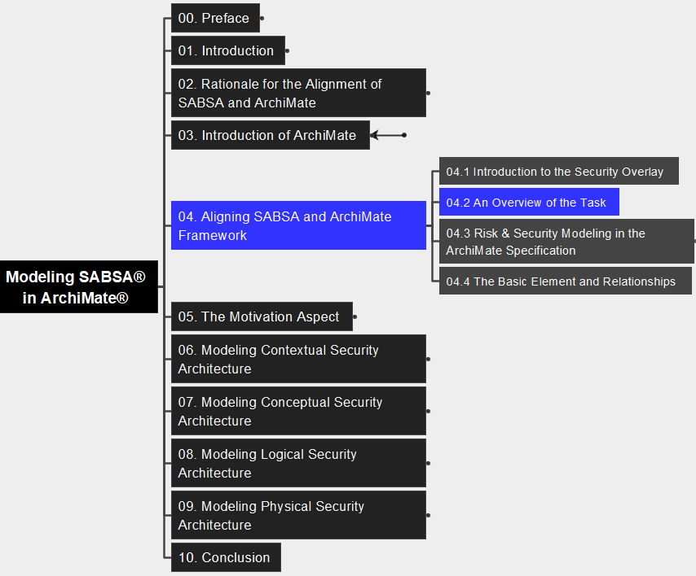
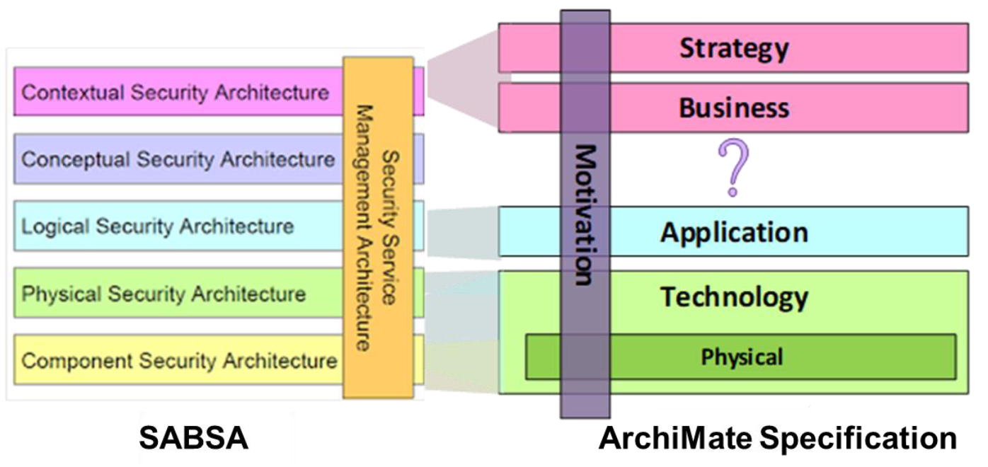
04 Aligning SABSA and ArchiMate 4.2 An Overview of the Task
12
Modeling SABSA® in ArchiMate® Specification

Slide 14
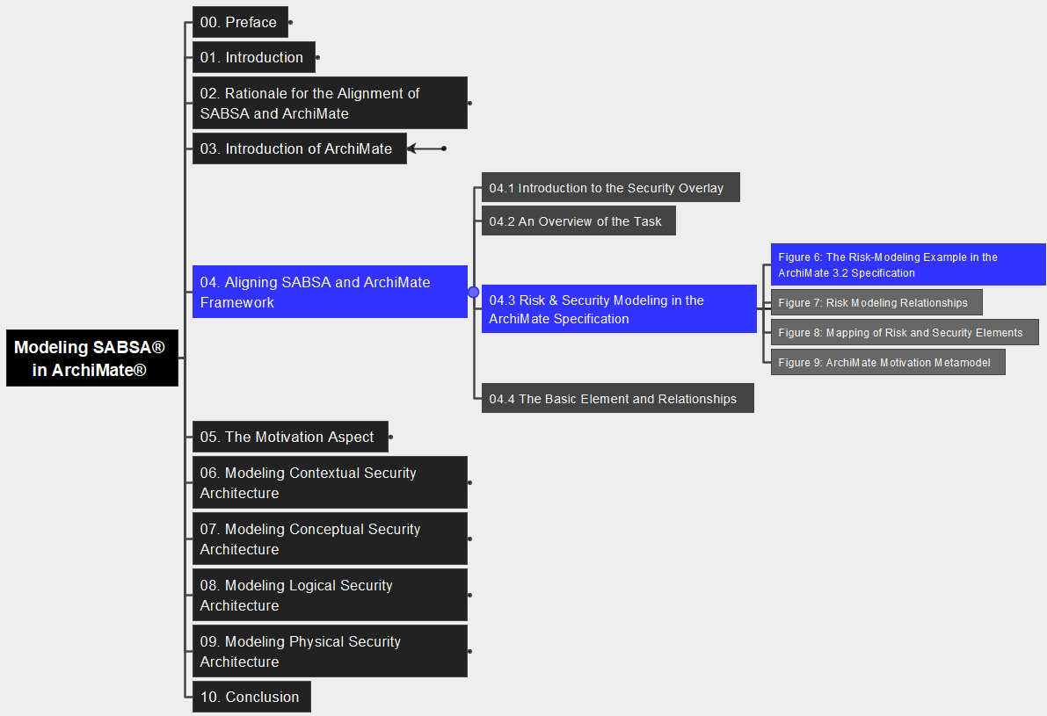
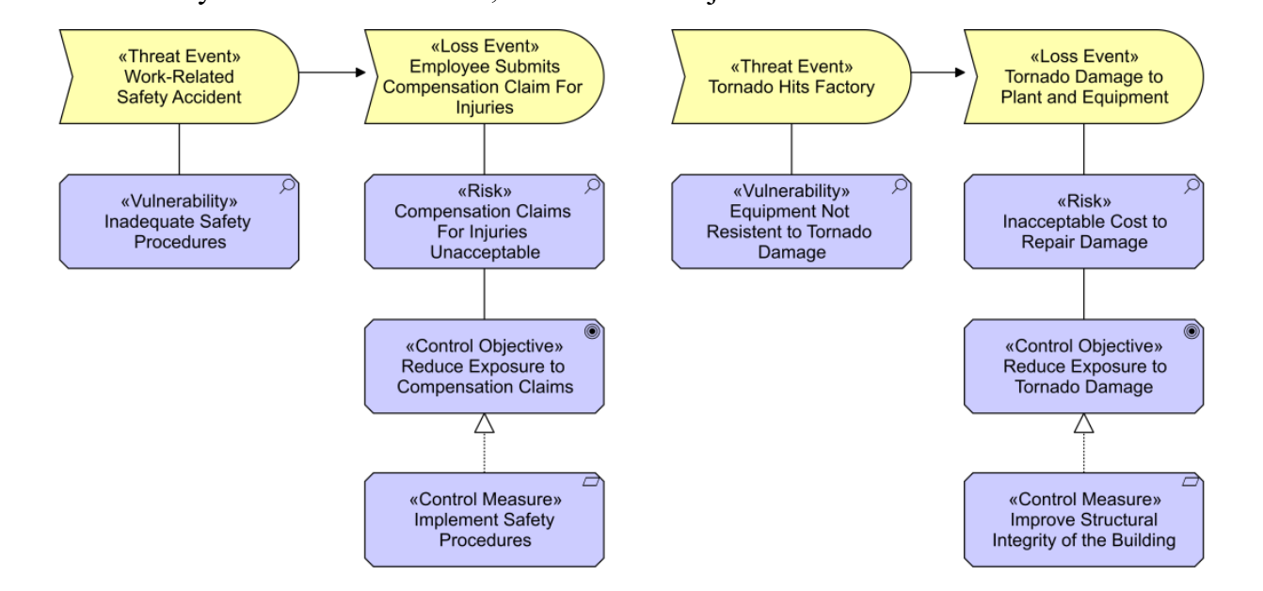
04 Aligning SABSA and ArchiMate 4.3 Risk & Security Modeling – Figure 6
13
Modeling SABSA® in ArchiMate® Specification

Slide 15
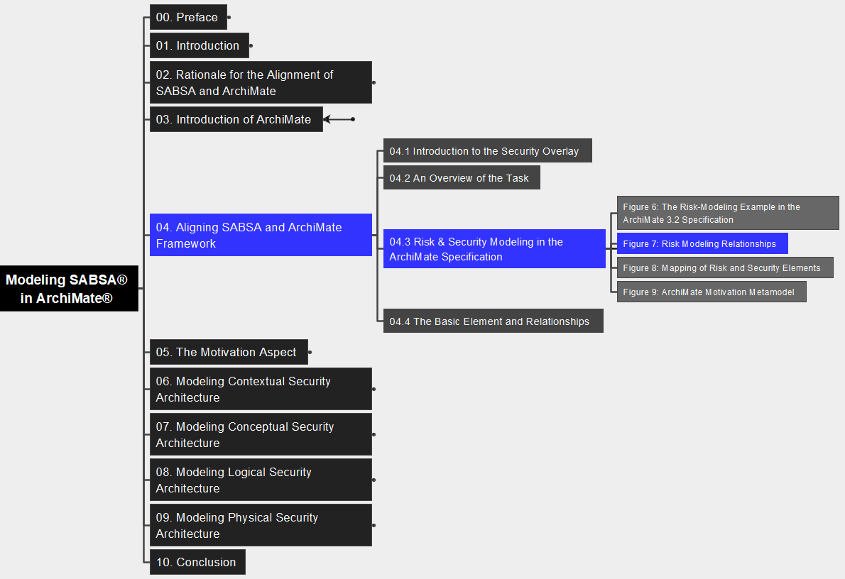
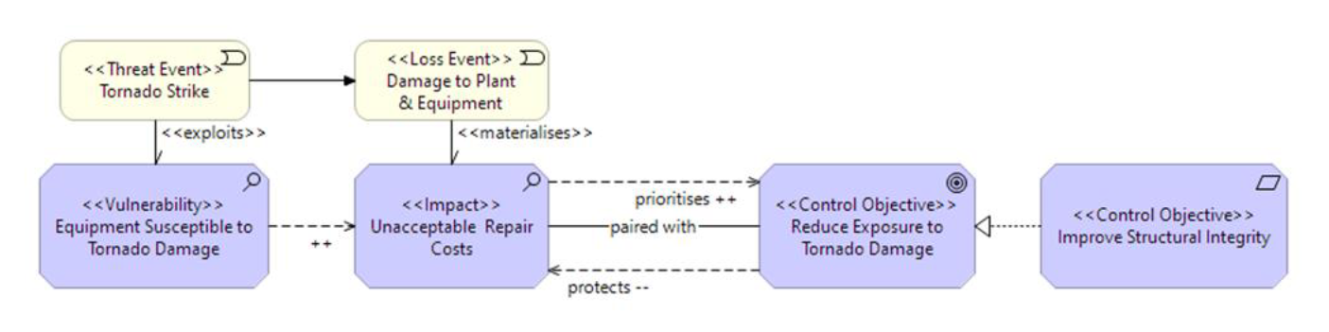
04 Aligning SABSA and ArchiMate 4.3 Risk & Security Modeling – Figure 7
14
Modeling SABSA® in ArchiMate® Specification

Slide 16
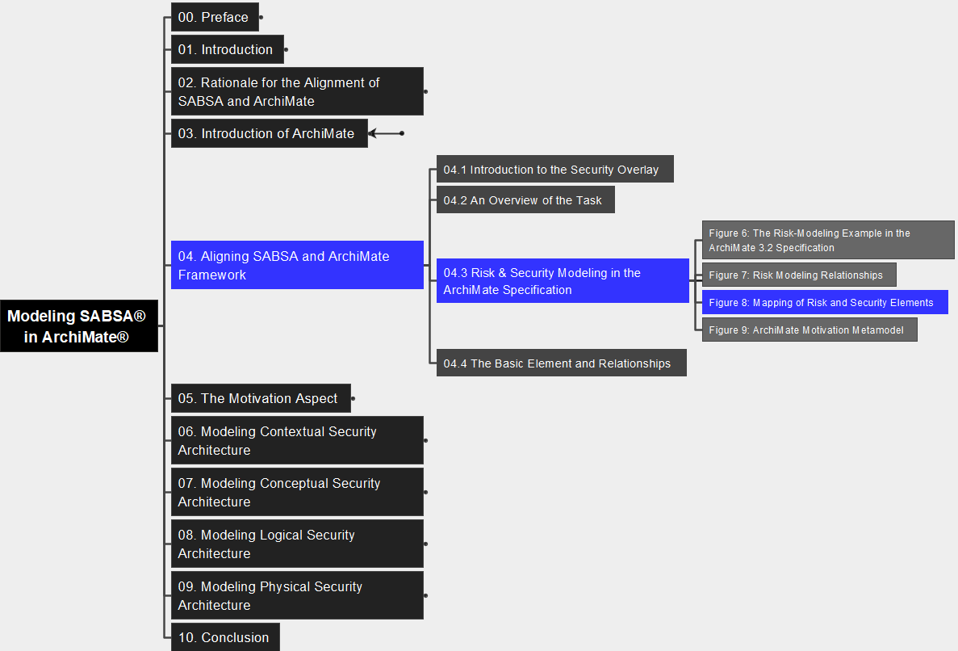
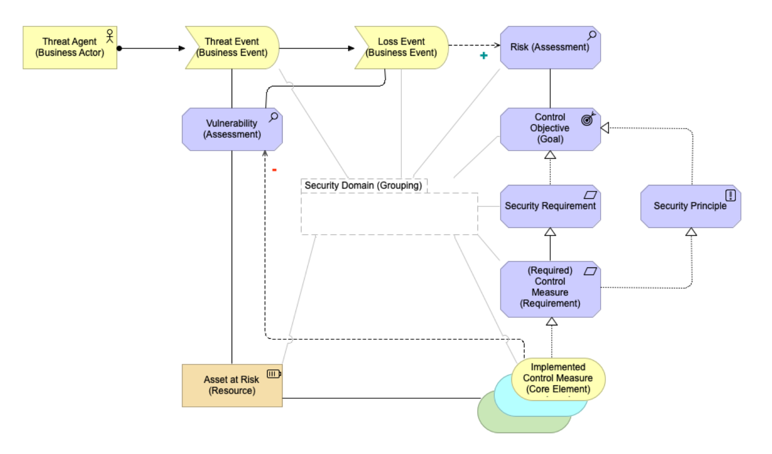
04 Aligning SABSA and ArchiMate 4.3 Risk & Security Modeling – Figure 8
15
Modeling SABSA® in ArchiMate® Specification

Slide 17


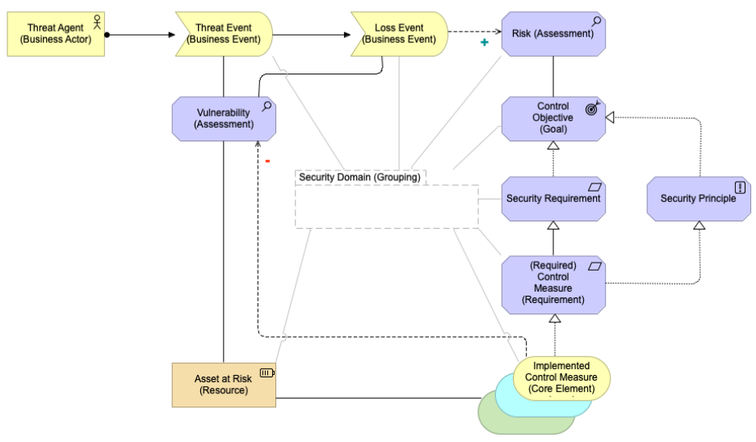
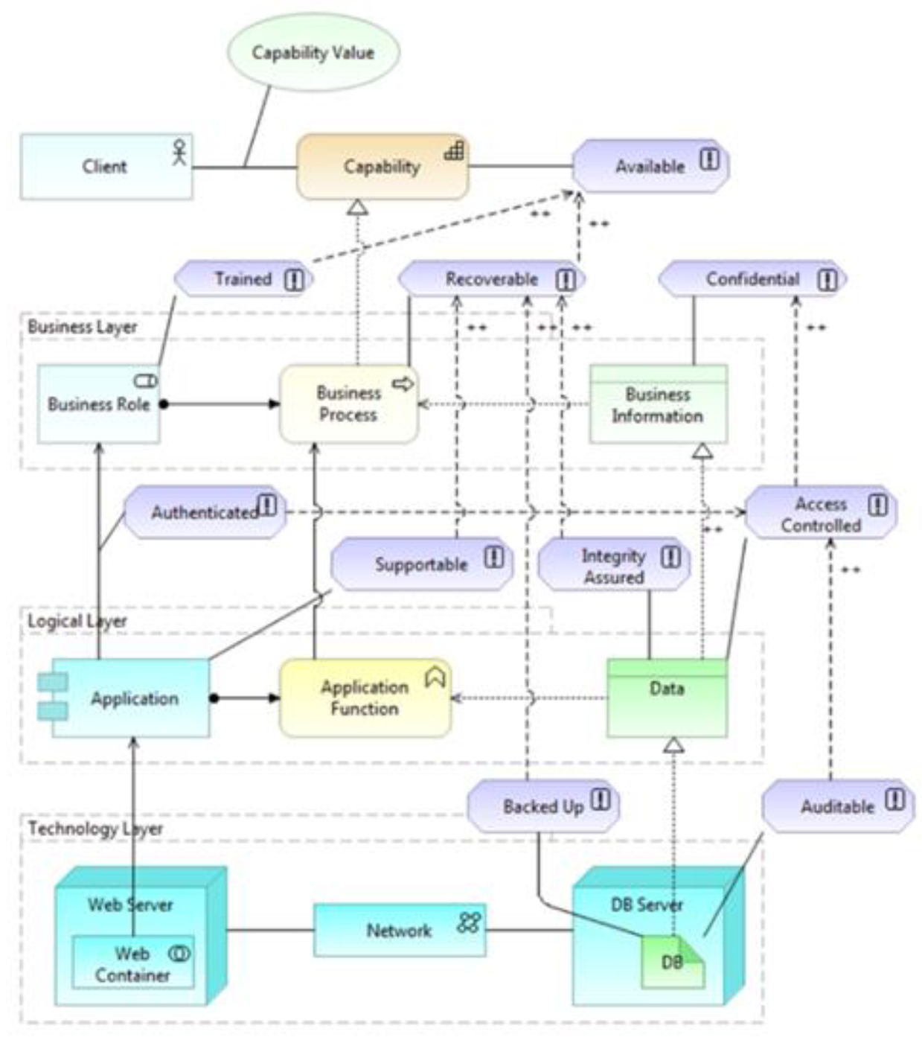
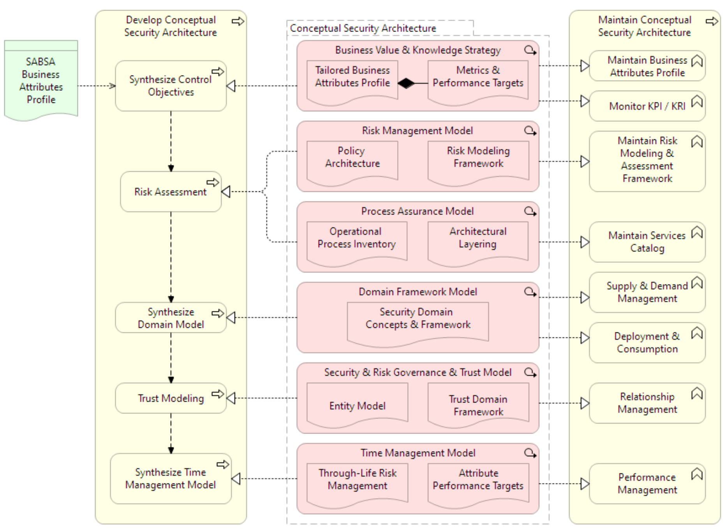
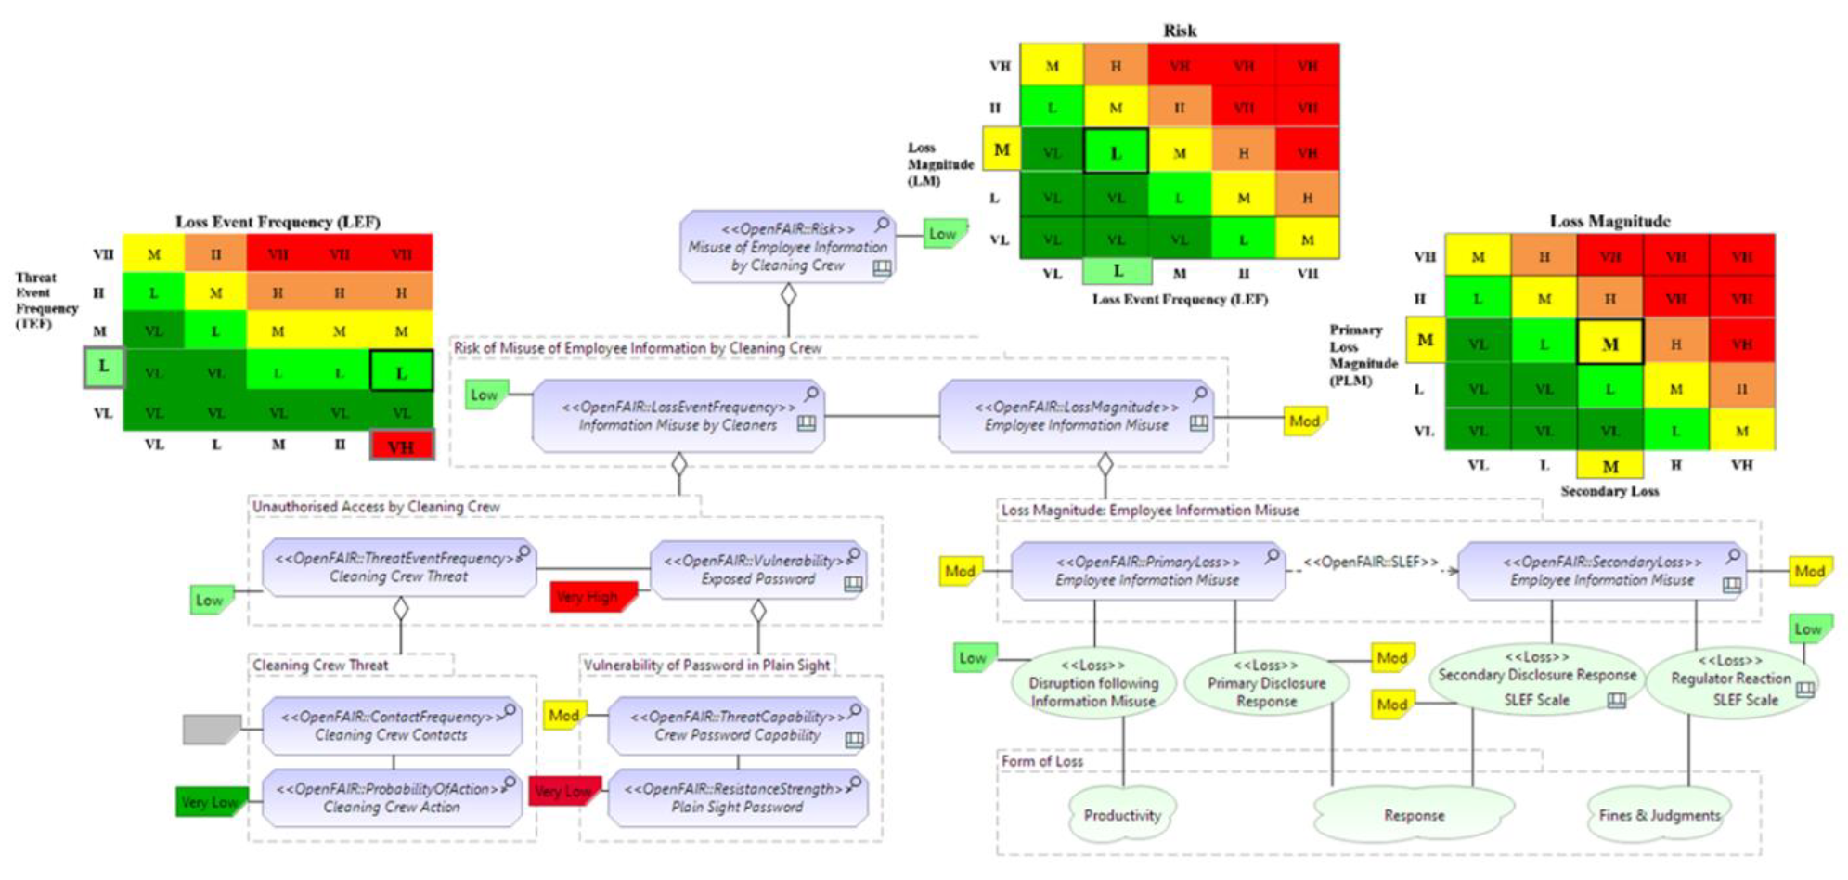

Slide 19




ArchiMate
UML
BPMN

